Slide 1

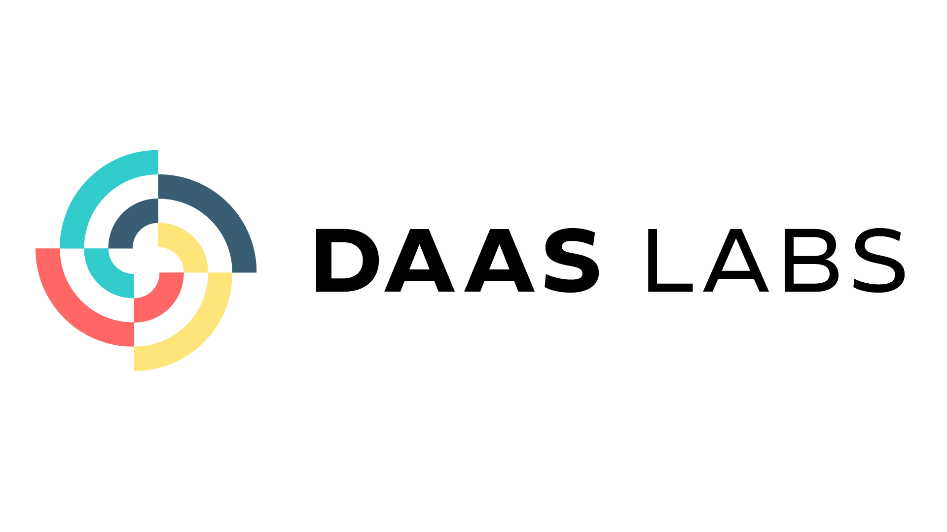

Slide 2

About DAAS LABS
DaasLabs specializes in data services and data fabric platforms, offering a unique blend of products and services. Our expertise in data engineering, generative AI, and computer vision, combined with a strong focus on data governance and maturity models, empowers organizations to maximize their data assets.
With accelerators, frameworks, and a rich knowledgebase, we provide clients with streamlined implementation, advanced analytics capabilities, and industry best practices for data-driven success.

Slide 3







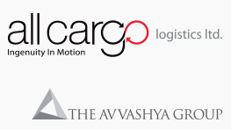



DAAS LABS
DaasLabs specializes in data services and data fabric platforms, offering a unique blend of products and services.
Our vision is to revolutionize the data landscape by providing end-to-end solutions that make data effortless, leveraging AI and machine learning to empower businesses to achieve their strategic objectives and drive growth.
Who we are
What We do
How we Add Value
Who we work With
Language Capabilities: Utilizing NLP, NLU, and NLG to help clients in various sectors make informed decisions with textual data
Vision Capabilities: Extracting insights from images and videos using OCR, AI, and ML.
Data Capabilities: Offering end-to-end data strategies and services across diverse industries.
Data platform: Brings one of the leading data platforms in the world.
Comprehensive Strategy:
DaasLabs creates customized data solutions aligned with clients' objectives.
Expertise in Key Areas: Specialized in data strategy, governance, security, and analytics.
Empowering Growth:
Aids organizations in unlocking data's potential for business growth.
We work with leading companies across the world Solving complex Data problems

Slide 4
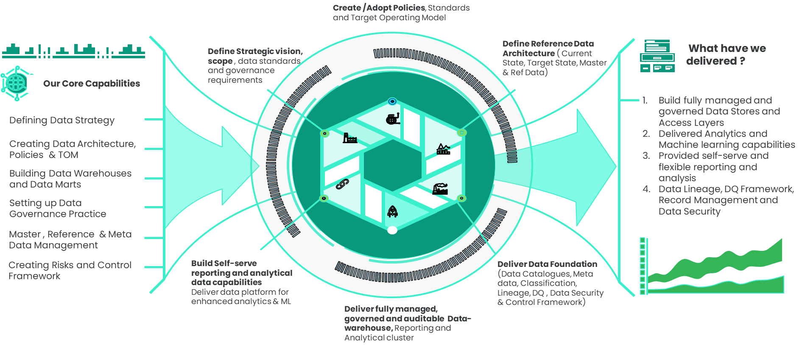
Data Practice
By simplifying and transforming the data journey, we empower organizations to make informed and strategic choices, optimize their operations, identify new revenue streams, enhance customer experiences, and drive innovation.

Slide 5

Banking
Centre of Excellence
Risk analytics
Regulatory Compliance
Data Governance
Operational Efficiency
Business Reporting
At DAAS LABS, we're transforming the banking sector through data-driven intelligence. Our dedicated Banking Centre of Excellence is fully equipped to handle the unique challenges faced by the industry.
Bank on Us for better Banking
Case studies

Slide 6
Auto Commentary
Global Bank Embraces Automation and NLP for Efficient Reporting
Situation
Challenge
Solution & Results
A top global bank in 90+ countries struggles with timely book closure and accurate reporting due to complex, error-prone financial processes, as highlighted by industry research. The CFO department's 300+ staff spend 25%-40% time on manual, low-value tasks, affecting productivity. Implementing automation and digitization
Manual financial processes cause delays, errors, and penalties, with significant time wasted on report generation and book closing. Industry research recommends finance automation and digital transformation, utilizing technologies like Natural Language Processing, for up to 50% cost savings, improved accuracy, and streamlined operations.
The bank adopts NLP and rule-based technologies to automate Balance Sheet and PnL Reports creation, integrating with Oracle GL/SAP for seamless data handling. Initially tested on Management Hierarchy, it's extended to Legal and Tax Hierarchy. Advanced analytics analyze account lines, with ownership mapping to alert account owners on variances.

Slide 7
Accounting Hub Design
Transforming Trade Management: Danish Bank Innovates with Robust, Efficient Accounting Hub Design
Situation
Challenge
Solution & Results
Due to increased trade volume, the Danish bank wants to build an Accounting Hub responsible for creating accounting entries and posting information to the Data Warehouse and ERP. The bank needs a scalable solution that meets the functional requirements of end users.
The existing manual process for creating accounting entries is time-consuming and error-prone. The bank requires a robust and efficient Accounting Hub that can handle the growing trade volume and integrate data from various operational systems.
The bank creates an Accounting Hub, streamlining data analysis, mapping, and model creation from various operational systems. Implementing data governance and metadata frameworks, alongside a tech-driven solution, automates accounting processes, reduces errors, improves data accuracy, and supports regulatory compliance, fostering efficient governance and operational excellence.

Slide 8
Banking Centre of Excellence
A Global Bank Establishes an Automation centre of excellence with Control Tower and Automation Foundry
Situation
Challenge
Solution & Results
Standard guidelines and a pipeline management process are developed for efficient project execution.
The setup promotes centralized governance, standardization, efficient project delivery, and performance monitoring, enabling effective management and scalability of automation initiatives, which in turn accelerates delivery, improves visibility, and drives continuous enhancements in automation practices.
The bank aims to establish a Command Control Tower for its Automation Center of Excellence (CoE) to centralize and streamline automation initiatives across different geographies and processes.
The bank needs to establish a centralized governance model, define automation standards and best practices, and provide a platform for collaboration and knowledge sharing among automation teams.

Slide 9
Data flow Design
Reimagining Intercompany Process: Tier 1 Global Bank Designs Optimized Data Flow for Enhanced Efficiency
Situation
Challenge
Solution & Results
A tier 1 bank needs to establish a robust data flow and information architecture for the intercompany process.
The existing intercompany process lacks efficiency and transparency due to fragmented data flow and a lack of standardized procedures.
The bank requires a well-designed data flow and information architecture to streamline the intercompany process.
The bank optimizes its intercompany process by developing a structured architecture, data model, and integration mechanisms, alongside implementing data governance and automation.
This redesign significantly enhances efficiency, transparency, data integrity, and process optimization, facilitating smoother, faster, and more reliable intercompany transactions.

Slide 10


Connect with us
https://daaslabs.ai/
sales@Daaslabs.ai

Slide 11
Bank on us
for better banking

Slide 12

SCIKIQ
Recognised as one of the Top Data Fabric Platforms Worldwide.
SCIKIQ is a PAAS-based, AI-Powered, No-Code business data platform that empowers business teams in medium to large organizations to unlock the power of their data in real-time, without the need to learn complex technology.
What We do
How we Add Value
Who we work With
A unified data management framework across complex multi-cloud and multi-vendor landscapes.
SCIKIQ Offers the following:
Data integration
Data curation
Data governance
Data Visualisation
SCIKIQ can be deployed anywhere to solve any data problem in any industry. The Key focus area are Supply chain, Retail and Banking.
SCIKIQ - Abstracting Complexities around Complex Ecosystem
A unique focus on putting the business lens and context on data, rather than pushing another tool and/or methodologies for faster compute and storage.
Scikiq's focus on ease of use, business-centric approach, and flexibility make it an ideal choice for organizations looking to quickly derive insights from their data and drive growth
We work with leading companies across the world.

